Slide 1
Leveraging the sustainability potential of mass customization through product service systems in the consumer electronics industry
by
STEPHAN HANKAMMER and FRANK STEINER
Presenting Author: STEPHAN HANKAMMER
RWTH Aachen University
Technology and Innovation Management Group
Aachen, Germany
hankammer@time.rwth-aachen.de

Slide 2
Agenda
The consumer electronics market
Consumer Electronics & Sustainability
The SMC-Excel project
Business Model Innovation Workshop
Literature review
Results
Summary

Slide 3
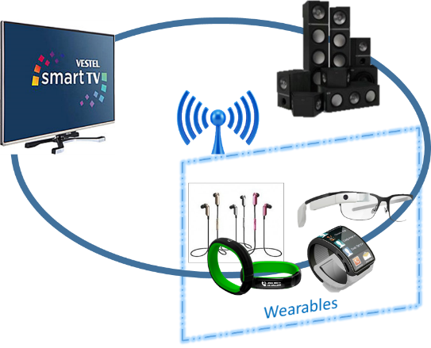
The Consumer Electronics Market
Consumer Electronics Sector
→ Rapid changes: Life cycles of CE products are getting shorter and shorter
= Highly influenced by technological developments.
→ Rising Demand: 2.5 Billion mobiles, tablets and computers in 2014 (Gartner 2014)

Slide 4
CE & Sustainability
CE = Typical example of mass production
Numerous environ-mental issues throughout the entire product life cycle:
Lack of resource efficient designs of appliances and processes
Increased use of raw material
Overproduction
Use of hazardous materials.
Costly processes for dismantling and recycling
Off-shore production = increasing energy demand (coal-fired power stations!) / transportation emissions

Slide 5
CE & Sustainability
CE & Sustainability:
Manufacturing-focused approaches
Eco efficiency
Eco design
Eco production
Ecodesign = “systematic integration of key environmental aspects of a product into the early stages of design and development” (Park et. al 2006)
Ecodesign = strategy, which attempts to enhance traditional patterns of production without considering other patterns of need satisfaction (Roy 2000)

Slide 6
SMC Excel Project
Development of new (greener) technologies
→ Technological change
New business models based on the business model pattern of Mass Customization
→ System(ic) change

Slide 7
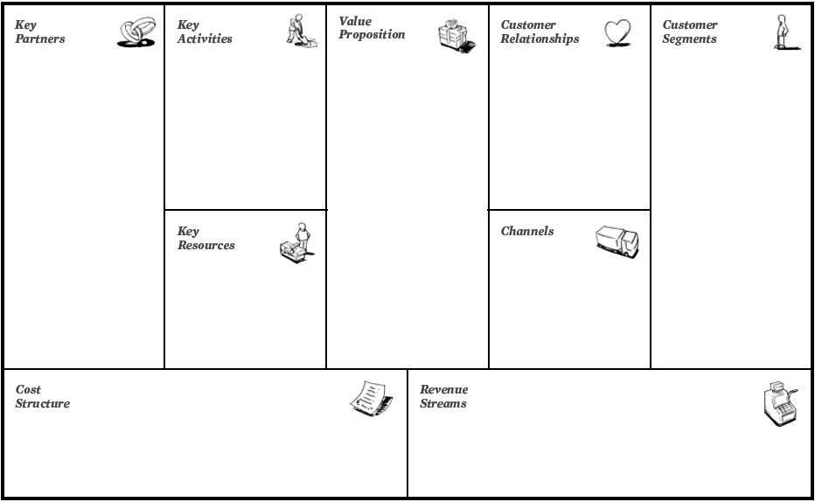
BMI Workshop, Nov 2015
Envision
New Business Models
around the
Core Business Model Pattern
of Mass Customization
!!! With positive environmental impact!!!

Slide 8
BMI Workshop, Nov 2015
Possible Customization Options
Environmental Impact / Measurement of environmental sustainability
Moment in the product life cycle
Usage
Retail & Logistics
End of Lifetime
Production

Slide 9
Literature review I: PSS and Sustainability
De-materialization of economy:
Decreasing number of products in the market
Total Resource reduction etc.
Higher responsibility of companies for their offered PSS
Higher probability that companies take back, upgrade, refurbish and reuse their products
Economic interest to extend material life, such as recycling, energy recovery or composting
New ways for companies to influence stake-holder relationships.
Consumers can more easily learn about environmental features of products / environmental use of product

Slide 10
Literature review II: Connectivity of PSS and MC
New opportunities for individualization
New sources of added customer value
Unique customer relationships through PSS for MC companies
Long-lasting relationships, increasing customer loyalty
Increasing responsibility for companies along the product life cycle
Interest of both, producer and consumer, to minimize life-cycle costs of the customized PSS

Slide 11
Results
BM based on MC and PSS = could surpass / complement traditional eco-design and eco-efficiency approaches.
Environmental outcome of such PSS and MC based BM still depend on how firms further combine these two patterns with other sustainability oriented patterns.
The full interplay of the different patterns determines whether the sustainability potential of MC can be leveraged or not.
Shift to a business model based on MC and PSS is an opportunity to create radical improvements and innovations that could go beyond incremental environmental improvements

Slide 12
Summary
SMC Excel Project:
Creating Business Models based on Mass Customization to enhance Sustainability of CE
Business Model Innovation Workshop:
Trying to develop Business Models with environmental impact using the pattern of MC
Result: Limited Possibilities to enhance sustainability through Hardware (and Software) Customization
Proposed Solution:
Linking MC pattern to PSS pattern and creating BM around these patterns
Literature analysis:
Proof ecologic benefits of PSS pattern
Proof connectivity of MC and PSS
Result:
PSS = ecological potential
Connectivity between MC and PSS is given
Integration of PSS-ideas into Customization Offering
Future Research
Empiric analysis: concept testing of business models with MC and PSS elements
Analysis of complexity

Slide 13
Some references
Roy, R., "Sustainable product-service systems,“ Futures, Vol. 32, No. 3–4, 2000, pp. 289-299.
ElMaraghy, H., Schuh, G., ElMaraghy, W., Piller, F., Schönsleben, P., Tseng, M., and Bernard, A., "Product variety management," CIRP Annals - Manufacturing Technology, Vol. 62, No. 2, 2013, pp. 629-652.
Badurdeen, F., Iyengar, D., Goldsby, T. J., Metta, H., Gupta, S., and Jawahir, I. S., "Extending total life-cycle thinking to sustainable supply chain design," International Journal of Product Lifecycle Management, Vol. 4, No. 1, 2009, pp. 49-67.
Boër, C. R., Pedrazzoli, P., Bettoni, A., and Sorlini, M., Mass customization and sustainability: an assessment framework and industrial implementation. London: Springer, 2013.
Kleer, R. and Steiner, F., "Mass Customization: Bridging Customer Integration and Sustainability? (Working Paper),“
Pourabdollahian, G., Steiner, F., Horn Rasmussen, O., and Hankammer, S., "A Contribution toward a Research Agenda: Identifying Impact Factors of Mass Customization on Environmental Sustainability," International Journal of Industrial Engineering and Management, Vol. 5, No. 4, 2014, pp. 169-178.
Sodhi, M. S. and Lee, S., "An analysis of sources of risk in the consumer electronics industry,“ Journal of the Operational Research Society, Vol. 58, No. 11, 2007, pp. 1430-1439.
Cobbing, M. and Dowdall, T., "Green Gadgets: Designing the Future - The path to greener electronics," Greenpeace International, Amsterdam 2014.
Osterwalder, A. and Pigneur, Y., Business Model Generation: A Handbook for Visionaries, Game Changers, and Challengers. Hoboken: John Wiley & Sons, 2010
Gassmann, O., Frankenberger, K., and Csik, M., The business model navigator: 55 models that will revolutionise your business. London: Pearson, 2014.
Salvador, F., De Holan, P. M., and Piller, F., "Cracking the Code of Mass Customization," MIT Sloan Management Review, Vol. 50, No. 3, 2009, pp. 71-78.
Tukker, A., Emmert, S., Charter, M., Vezzoli, C., Sto, E., Munch Andersen, M., Geerken, T., Tischner, U., and Lahlou, S., "Fostering change to sustainable consumption and production: an evidence based view," Journal of Cleaner Production, Vol. 16, No. 11, 2008, pp. 1218-1225.
Mont, O. K., "Clarifying the concept of product-service system," Journal of Cleaner Production, Vol. 10, No. 3, 2002, pp. 237-245.
Vezzoli, C., Kohtala, C. and Srinivasan, A., “Product Service System Design for Sustainability,” Greenleaf Publishing: Sheffield, 2014.
Leismann, K., Schmitt, M., Rohn, H., and Baedeker, C., "Collaborative Consumption: Towards a Resource-Saving Consumption Culture," Resources, Vol. 2, No. 3, 2013, pp. 184-203.

Slide 14
Discussion
www.smc-excel.eu

